Slide 1


Student Details
Name : Rayapu varshitha
Skillsbuild email id : varshitha_rayapu@srmap.edu.in
College name : srm university- ap
College state : Guntur, Andhra Pradesh
Internship domain and internship start and end date : data analytics / [June 3rd – July 25th ]

Slide 2
Analysis of CarDekho Dataset
To analyze the CarDekho dataset to extract meaningful insights regarding vehicle sales, price trends, and factors affecting vehicle prices, thereby aiding decision-making for buyers and sellers.

Slide 3
AGENDA
Problem Statement
Project Overview
End Users
Solution and Value Proposition
Customization and Personalization
Data Modelling
Results
Links

Slide 4
PROJECT OVERVIEW
PURPOSE
To analyze the CarDekho dataset to understand the factors influencing car prices and sales.
SCOPE
Dataset description and cleaning
Exploratory Data Analysis (EDA)
Key insights and conclusions
Challenges and future work

Slide 5
Objectives
Identify price distribution and trends
Analyze the impact of various factors like fuel type, transmission, and ownership on car prices
Provide data-driven recommendations for buyers and sellers

Slide 6
WHO ARE THE END USERS of this project?
Primary End Users:
Car buyers: To make informed purchasing decisions
Car sellers: To understand market trends and set competitive prices
Automotive market analysts: To study market dynamics and trends
Few organizations which are into car selling :
CarTrade
QuickCars
OLX Autos Sale Car
Carandbike
CarDheko

Slide 7
YOUR SOLUTION AND ITS VALUE PROPOSITION
Manufacturing year range : Vehicles in the data range from 2003 to 2018.
Lowest price sold : The lowest price a vehicle was sold for is 0.1 lakhs.
Highest price sold : The highest price a vehicle was sold for is 35.0 lakhs.
Total records : There are 301 records in the dataset.
Missing records : There are no missing records in the dataset.
Different vehicles : There are 98 different vehicles present in the dataset.
Most sold vehicle : The most sold vehicle is the Honda City.
CNG vehicles count : There are 2 CNG vehicles in the dataset.
Vehicles for sale by individuals : 106 vehicles are for sale from individuals directly.
Auto transmission vehicles : The dataset contains 40 automatic transmission vehicles.

Slide 8
Single person owned vehicles : There are 290 vehicles owned by a single person.
Most cost depreciated vehicle : The vehicle with the highest depreciation is Land cruiser.
Least cost depreciated vehicle : The vehicle with the lowest depreciation is Honda Activa 4G.
Factors affecting depreciation : Cost depreciation is influenced by factors such as vehicle age and distance driven.
Newest vehicles after 2014 : The dataset contains 147 vehicles manufactured after 2014.
Two-wheelers data and oldest bike : The dataset includes two-wheelers, with the oldest bike sold in 2003.
Cars data : The dataset includes cars with present prices above 3.5 lakhs.
Oldest car : The oldest car sold had a selling price of 0.1 lakhs.

Slide 9
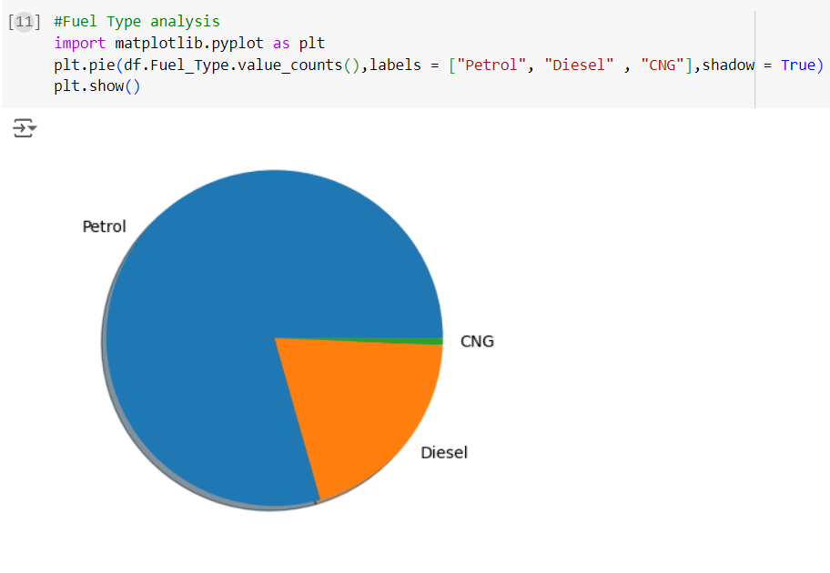
How did you customize the project and make it your own
The pie chart analysis of fuel types in the vehicle dataset reveals a dominant preference for petrol vehicles, which constitute the majority of the data. Diesel vehicles are the second most common, while CNG vehicles have the smallest share. This distribution indicates that petrol engines are more popular, likely due to their availability and lower upfront costs. Despite the environmental benefits of CNG, their limited presence suggests slower adoption of alternative fuels. This distribution provides insights into market trends, consumer preferences, and the potential direction for future vehicle sales and environmental policies.

Slide 10
MODELLING
Methodology
Data Import and Preprocessing
Loaded the CarDekho dataset.
Cleaned data to ensure no missing values and treated outliers.
Exploratory Data Analysis (EDA)
Conducted detailed analysis to uncover patterns and trends in car prices based on various factors.

Slide 11
Insights Extraction
Derived key findings regarding price distribution, car age, kms driven, fuel type, seller type, transmission, and ownership impact on price.
Tools Used
Python (Pandas, NumPy)
Google Colab
Visualization Libraries (Matplotlib, Seaborn)

Slide 12
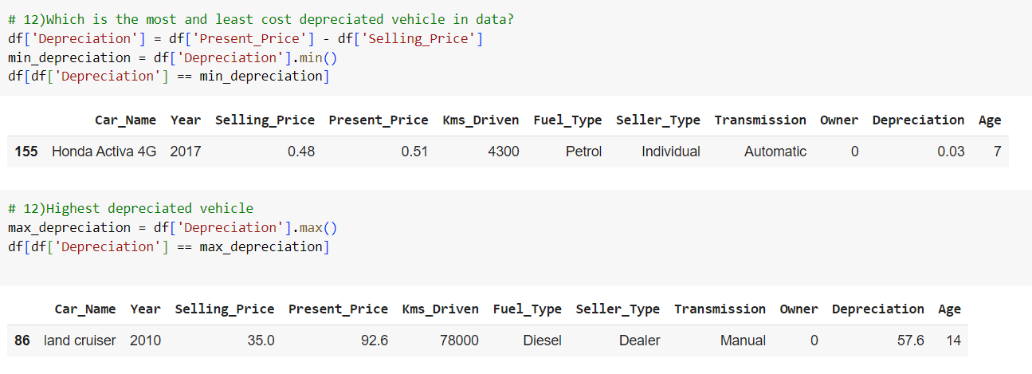
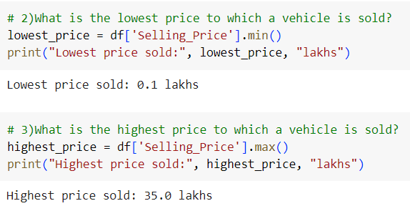
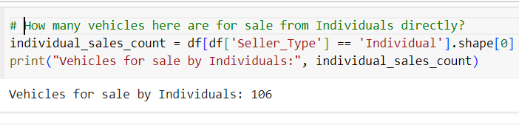
Results
Price Distribution
Depreciation

Slide 13
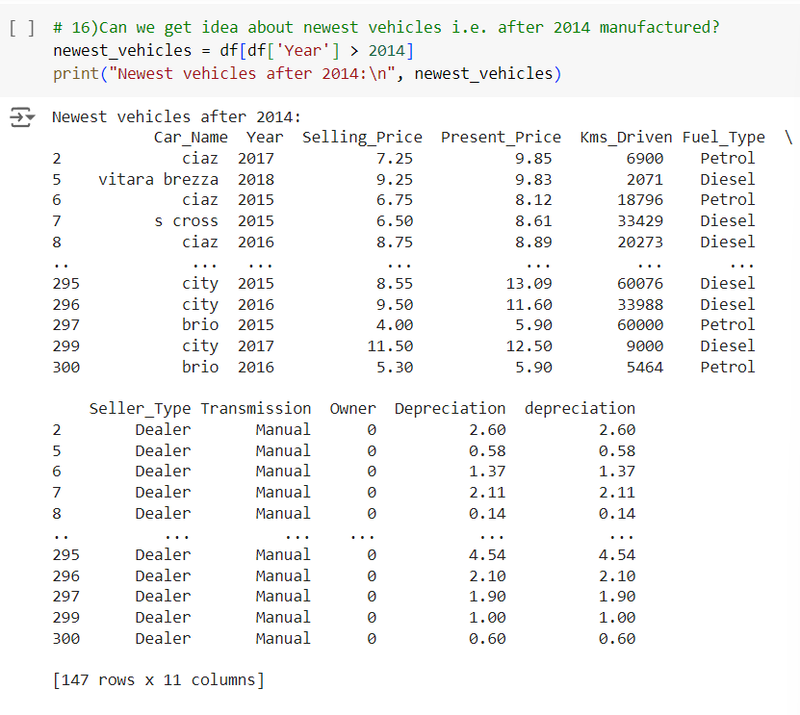
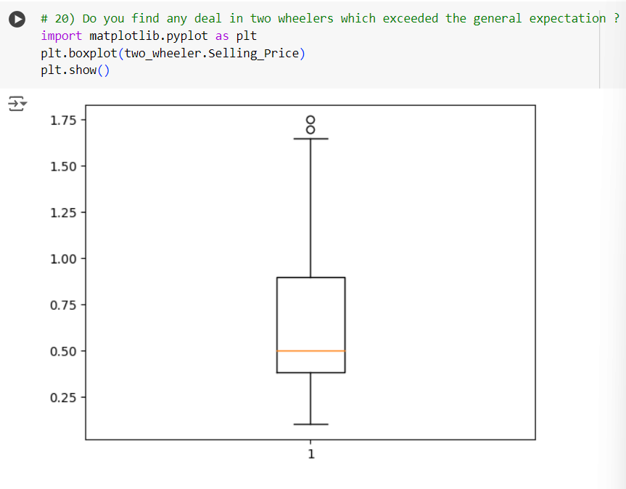

Slide 14
links
https://github.com/Varshitha236/Car_Dekho_Project

